Slide 1
IS 120
The Internet / Intro to HTML

Slide 2

What Is the Internet?
Computers talking to computers
In this class, your computer will be “talking to itself” a lot
Notes:
This is important, because in this class your computer will be “talking to itself” in a sense

Slide 3
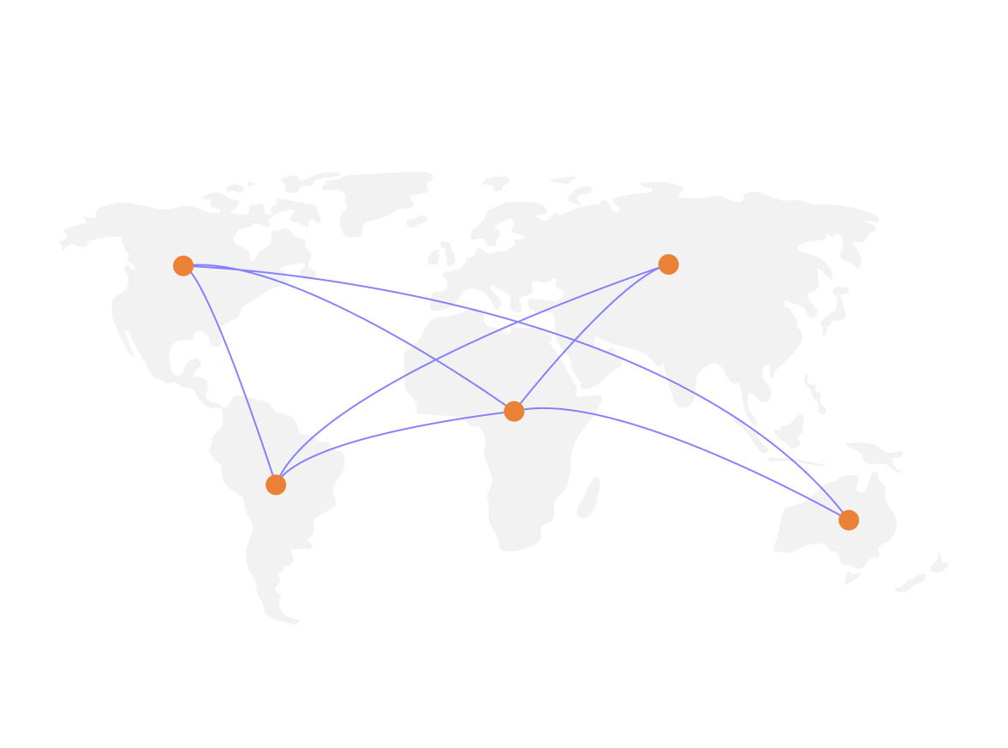
What Is the Internet?
Non-centralized, distributed network

Slide 4
What Is the Internet Made Of?
Clients
Computers that ask for websites (Phone, laptop, etc.)
Servers
Computers that store and send websites
Connections
Cables and wireless connections
https://www.submarinecablemap.com/

Slide 5
How Websites are Delivered
Browser
An application that can to request and receive websites
What every browser knows about you
  https://webkay.robinlinus.com/
A browser renders websites using HTML, CSS, and JavaScript

Slide 6
What is HTML?
HyperText Markup Language
HTML is NOT a programming language
  It does not contain logic or instructions
  Think of HTML as a blueprint
HTML was originally built to mimic books and articles
  https://www.cnn.com/US/OJ/verdict/index.html

Slide 7
Intro to HTML
Open VS Code

